Slide 1

TRIPPIE
Peer to Peer Transport application
BRIAN, HENRY, KELYN, NEHA, SANKET, THOMAS, YUN

Slide 2

CLIENT
Dr Fadi Fayez (Thabtah)
Expertise in:
Machine Learning
Data Analytics
Computer Security
Autism Screening
Medical Informatics

Slide 3



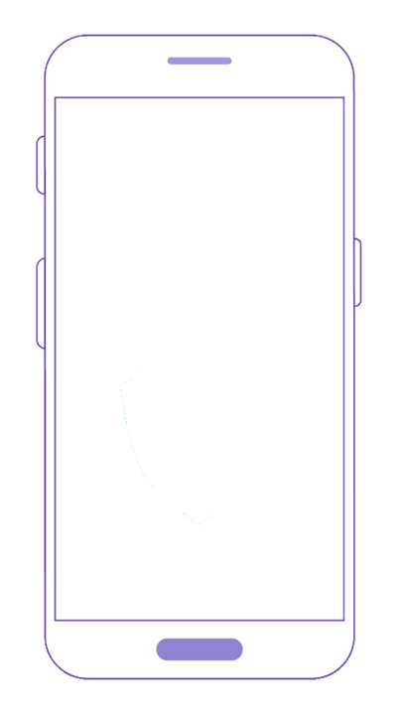
Business OPPORTUNITY
Conventional transport companies are often expensive and inconvenient.
Growth of the sharing economy .
Opportunity for our client to emulate and out compete other successful companies from other countries.
4 million cubic metres goes to waste every day (Utake, 2019).
Underutilized resource turned into a competitor to an established industry?
Trippie idea. An on-demand transport app that connects senders with service providers.
Cargo can in a sense carpool with travelers.

Slide 4
Deliverables
Android Application
Website
Video Tutorials
Social Media Presence
Admin Panel
Documentation

Slide 5


Success Criteria
Customer Functionalities
Tripster Functionalities
Payment Processing
Arrange to have items or animals transported
Create, edit and cancel Trippies
Receive and then accept and decline offers
Communicate with the Tripster
Arrange to transport items or animals in return for a payment
View Trippies and offer to complete these Trippies
Notify customer about the delivery progress
Communicate with the customer
Raises complex legal issues
Involment of third party payment processing company
Most services tailored for websites

Slide 6
Project Methodology
Incremental Method
Multiple sequential development cycles
Cycles divided into smaller iterations
Iteration goes through a set of defined phases
Falls under Agile Software Development
REQUIREMENT ANALYSIS
IMPLEMENTATION
TESTING
EVALUATION
PLANNING

Slide 7
Learning Experience
Git
GitHub
Firebase
Cloud Functions
Security Standards
Legal Terminology
Marketing Research
WordPress
Payment Gateways

Slide 8
Challenges
Scope Creep
Delays
Pricing Algorithm
First Prototype for Testing
Database Costs
Insurance
Payment Provider
Large Team Coordination
Competition
Deadlines
Research
Literature Review

Slide 9

Demo

Slide 10

Questions?

